Slide 1
Object oriented analysis and design
Module 6: Others UML Diagrams

Slide 2
Objectives
Demonstrate how to read and interpret a:
State machine diagram : trạng thái
Component diagram: thành phần
Deployment diagram: triển khai

Slide 3
Where Are We?
State machine diagrams
Component diagrams
Deployment diagrams

Slide 4
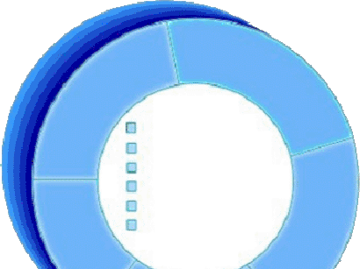

Review: An Object Has State
State is a condition or situation during the life of an object, which satisfies some condition, performs some activity, or waits for some event.
The state of an object normally changes over time.
Name: J Clark Employee ID: 567138 HireDate: 07/25/1991 Status: Tenured Discipline: Finance MaxLoad: 3
Name: J Clark Employee ID: 567138
Date Hired: July 25, 1991 Status: Tenured Discipline: Finance
Maximum Course Load: 3 classes
Professor Clark

Slide 5
Example: Professor
There are a sequence of events before an instructor becomes a University professor.
Assistant professor: trợ lí (achieves tenure by producing a number of quality publications)
Tenure/Associate professor
Professor (based on seniority)

Slide 6

What Are State Machine
Diagrams?
A state machine diagram models dynamic behavior.
It specifies the sequence of states in which an object can exist:
The events and conditions that cause the object to reach those states
The actions that take place when those states are reached
Assistant Professor
Tenured

Slide 7
Special States
The initial state is the state entered when an object is created.
An initial state is mandatory.
Only one initial state is permitted.
The initial state is represented as a solid circle.
A final state indicates the end of life for an object.
A final state is optional.
A final state is indicated by a bull’s eye.
More than one final state may exist.
Applied

Slide 8
What Are Events?
An event is the specification of a significant occurrence that has a location in time and space.
An event is an occurrence of a stimulus that can trigger a state transition.
Example:
Successful publication of numerous papers
Event
Assistant Professor
Tenured

Slide 9
What Are Transitions?
A transition is a change from an originating state to a successor state as a result of some stimulus.
– The successor state could possibly be the originating state.
A transition may take place in response to an event.
Transitions can be labeled with event names.
Assistant Professor
Tenured
maxPapers
Transition
Event Name

Slide 10



Example: State Machine
Hired
accepted
Assistant Professor
Applied
H
maxPapers
rejected
Tenured
seniority
retired
Professor
H
takeSabbatical
return
Hiatus

Slide 11
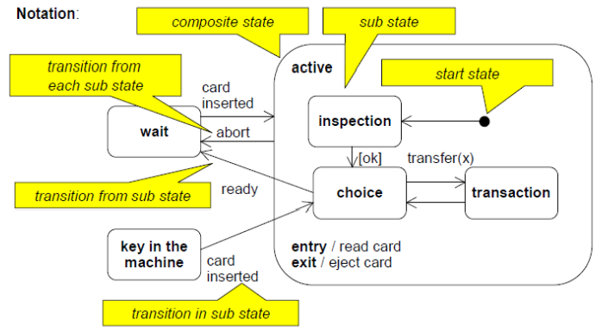
Composite States

Slide 12
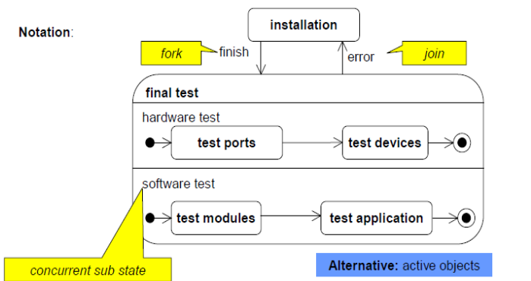
Concurrent Sub States
In a state several sequences of sub states described by own state machines can be performed concurrently.

Slide 13
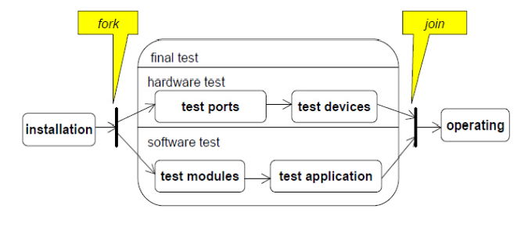
Concurrent Sub States: Alternative

Slide 14
Where Are We?
State machine diagrams
Component diagrams
Deployment diagrams

Slide 15

What Is a Component Diagram?
A diagram that shows the organizations and dependencies among components
<<component>>
ComponentA
<<component>> ComponentB
<<component>> ComponentC
<<component>> ComponentD

Slide 16

What Is a Component?
A modular part of a system that hides its implementation behind a set of external interfaces.
– Part of a logical or physical system
It conforms to and provides the physical realization of a set of interfaces.
It specifies the physical dependency to interfaces it requires.
<<component>>
ComponentName
<<component>>
Component Name
Provided Interface Name
Required Interface
Name

Slide 17
Where Are We?
State machine diagrams
Component diagrams
Deployment diagrams

Slide 18
What Is a Deployment Diagram?
The deployment diagram shows:
Configuration of processing nodes at run-time
Communication links between these nodes
Deployed artifacts that reside on them

Slide 19
What Is a Node?
Represents a run-time computational resource
Generally has at least memory and often processing capability.
Types:
Device
Physical computational resource with processing capability.
May be nested
Execution Environment
Represent particular execution platforms
<<device>> Device Name
<<device>> Sub Device Name
<<exe env>> EE Name

Slide 20
What Is a Connector?
A connector represents a:
Communication mechanism
Physical medium
Software protocol
<<client workstation>>
Kiosk
<<100-T Ethernet>>
<<application server>> Server
Connector
<<client workstation>> Console
<<RS-232>>

Slide 21
Example: Deployment Diagram
<<client workstation>> PC
<<Campus LAN>>
0..2000
1
<<application server>> Registration Server
1
<<Campus LAN>>
<<Campus LAN>>
1
1
1
<<legacy RDBMS>> Course Catalog
<<legacy>>
Billing System

Slide 22
Example: Deployment Diagram with Processes
<<client workstation>> PC StudentApplication
us LAN>> | 0..2000
<<Camp
1
<<application server>> Registration Server
CourseCatalogSystemAccess CourseRegistrationProcess BillingSstemAccess
1
<<Campus LAN>>
1
<<Campus LAN>>
1
1
<<legacy RDBMS>> Course Catalog
<<legacy>>
Billing System

Slide 23

Review
Define state. How do you determine the classes with significant state?
What is a state machine diagram? Describe the different parts of the diagram.
What is a component diagram?
What is the purpose of a deployment diagram?

